Slide 1
Basic Business Statistics
11th Edition
Chapter 7
Sampling and Sampling Distributions
Basic Business Statistics, 11e © 2009 Prentice-Hall, Inc.
Chap 7-1

Slide 2
Learning Objectives
In this chapter, you learn:
To distinguish between different sampling methods
The concept of the sampling distribution
To compute probabilities related to the sample mean and the sample proportion
The importance of the Central Limit Theorem
Basic Business Statistics, 11e © 2009 Prentice-Hall, Inc..
Chap 7-<number>

Slide 3
Why Sample?
Selecting a sample is less time-consuming than selecting every item in the population (census).
Selecting a sample is less costly than selecting every item in the population.
An analysis of a sample is less cumbersome and more practical than an analysis of the entire population.
Basic Business Statistics, 11e © 2009 Prentice-Hall, Inc..
Chap 7-<number>

Slide 4
A Sampling Process Begins With A Sampling Frame
The sampling frame is a listing of items that make up the population
Frames are data sources such as population lists, directories, or maps
Inaccurate or biased results can result if a frame excludes certain portions of the population
Using different frames to generate data can lead to dissimilar conclusions
Basic Business Statistics, 11e © 2009 Prentice-Hall, Inc..
Chap 7-<number>

Slide 5
Types of Samples
Samples
Non-Probability Samples
Probability Samples
Simple
Random
Stratified
Judgment
Convenience
Systematic
Cluster
Basic Business Statistics, 11e © 2009 Prentice-Hall, Inc..
Chap 7-<number>

Slide 6
Types of Samples:
Nonprobability Sample
In a nonprobability sample, items included are chosen without regard to their probability of occurrence.
  In convenience sampling, items are selected based only on the fact that they are easy, inexpensive, or convenient to sample.
  In a judgment sample, you get the opinions of pre-selected experts in the subject matter.
Basic Business Statistics, 11e © 2009 Prentice-Hall, Inc..
Chap 7-<number>

Slide 7
Types of Samples:
Probability Sample
In a probability sample, items in the sample are chosen on the basis of known probabilities.
Probability Samples
Simple
Random
Systematic
Stratified
Cluster
Basic Business Statistics, 11e © 2009 Prentice-Hall, Inc..
Chap 7-<number>

Slide 8
Probability Sample:
Simple Random Sample
Every individual or item from the frame has an equal chance of being selected
Selection may be with replacement (selected individual is returned to frame for possible reselection) or without replacement (selected individual isn’t returned to the frame).
Samples obtained from table of random numbers or computer random number generators.
Basic Business Statistics, 11e © 2009 Prentice-Hall, Inc..
Chap 7-<number>

Slide 9
Selecting a Simple Random Sample Using A Random Number Table
Portion Of A Random Number Table
49280 88924 35779 00283 81163 07275
11100 02340 12860 74697 96644 89439
09893 23997 20048 49420 88872 08401
Sampling Frame For Population With 850 Items
Item Name Item #
Bev R. 001
Ulan X. 002
. .
. .
. .
. .
Joann P. 849
Paul F. 850
The First 5 Items in a simple random sample
Item # 492
Item # 808
Item # 892 -- does not exist so ignore
Item # 435
Item # 779
Item # 002
Basic Business Statistics, 11e © 2009 Prentice-Hall, Inc..
Chap 7-<number>

Slide 10


Probability Sample:
Systematic Sample
Decide on sample size: n
Divide frame of N individuals into groups of k individuals: k=N/n
Randomly select one individual from the 1st group
Select every k^{th} individual thereafter
N = 40
n = 4
k = 10
First Group
Basic Business Statistics, 11e © 2009 Prentice-Hall, Inc..
Chap 7-<number>

Slide 11
Basic Business Statistics, 11e © 2009 Prentice-Hall, Inc..
Chap 7-<number>

Slide 12
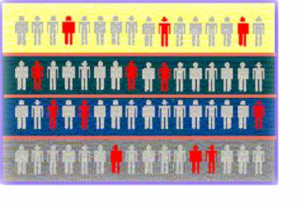
Probability Sample:
Stratified Sample
Divide population into two or more subgroups (called strata) according to some common characteristic
A simple random sample is selected from each subgroup, with sample sizes proportional to strata sizes
Samples from subgroups are combined into one
This is a common technique when sampling population of voters, stratifying across racial or socio-economic lines.
Population
Divided
into 4
strata
Basic Business Statistics, 11e © 2009 Prentice-Hall, Inc..
Chap 7-<number>

Slide 13
Probability Sample
Cluster Sample
Population is divided into several “clusters,” each representative of the population
A simple random sample of clusters is selected
All items in the selected clusters can be used, or items can be chosen from a cluster using another probability sampling technique
A common application of cluster sampling involves election exit polls, where certain election districts are selected and sampled.
Population divided into 16 clusters.
Randomly selected clusters for sample
Basic Business Statistics, 11e © 2009 Prentice-Hall, Inc..
Chap 7-<number>

Slide 14
Probability Sample:
Comparing Sampling Methods
Simple random sample and Systematic sample
  Simple to use
  May not be a good representation of the population’s underlying characteristics
Stratified sample
  Ensures representation of individuals across the entire population
Cluster sample
  More cost effective
  Less efficient (need larger sample to acquire the same level of precision)
Basic Business Statistics, 11e © 2009 Prentice-Hall, Inc..
Chap 7-<number>

Slide 15
Evaluating Survey Worthiness
What is the purpose of the survey?
Is the survey based on a probability sample?
Coverage error – appropriate frame?
Nonresponse error – follow up
Measurement error – good questions elicit good responses
Sampling error – always exists
Basic Business Statistics, 11e © 2009 Prentice-Hall, Inc..
Chap 7-<number>

Slide 16
Types of Survey Errors
Coverage error or selection bias
  Exists if some groups are excluded from the frame and have no chance of being selected
Non response error or bias
  People who do not respond may be different from those who do respond
Sampling error
  Variation from sample to sample will always exist
Measurement error
  Due to weaknesses in question design, respondent error, and interviewer’s effects on the respondent (“Hawthorne effect”)
Basic Business Statistics, 11e © 2009 Prentice-Hall, Inc..
Chap 7-<number>

Slide 17
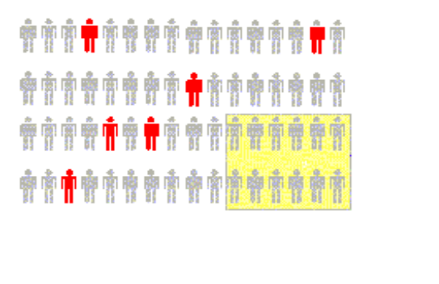

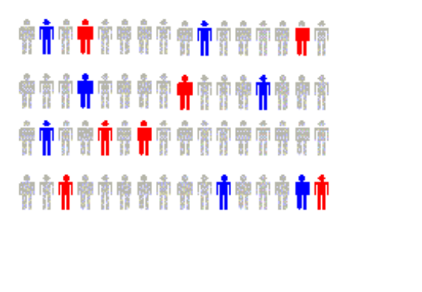

Types of Survey Errors
(continued)
Coverage error
Non response error
Sampling error
Measurement error
Excluded from frame
Follow up on nonresponses
Random differences from sample to sample
Bad or leading question
Basic Business Statistics, 11e © 2009 Prentice-Hall, Inc..
Chap 7-<number>

Slide 18
Sampling Distributions
A sampling distribution is a distribution of all of the possible values of a sample statistic for a given size sample selected from a population.
For example, suppose you sample 50 students from your college regarding their mean GPA. If you obtained many different samples of 50, you will compute a different mean for each sample. We are interested in the distribution of all potential mean GPA we might calculate for any given sample of 50 students.
Basic Business Statistics, 11e © 2009 Prentice-Hall, Inc..
Chap 7-<number>

Slide 19



Developing a
Sampling Distribution
Assume there is a population …
Population size N=4
Random variable, X,
is age of individuals
Values of X: 18, 20,
22, 24 (years)
D
A
B
C
Basic Business Statistics, 11e © 2009 Prentice-Hall, Inc..
Chap 7-<number>

Slide 20
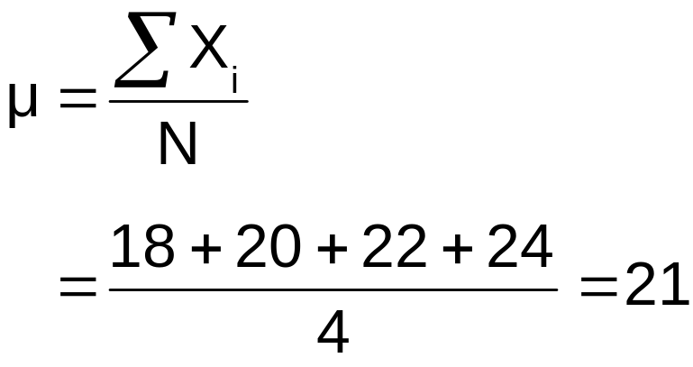
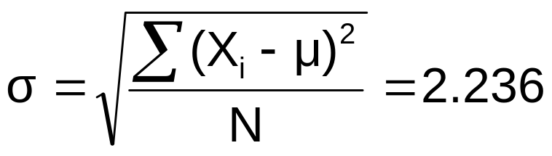
Developing a
Sampling Distribution
(continued)
Summary Measures for the Population Distribution:
P(x)
.3
.2
.1
0
18 20 22 24
A B C D
x
Uniform Distribution
Basic Business Statistics, 11e © 2009 Prentice-Hall, Inc..
Chap 7-<number>

Slide 21
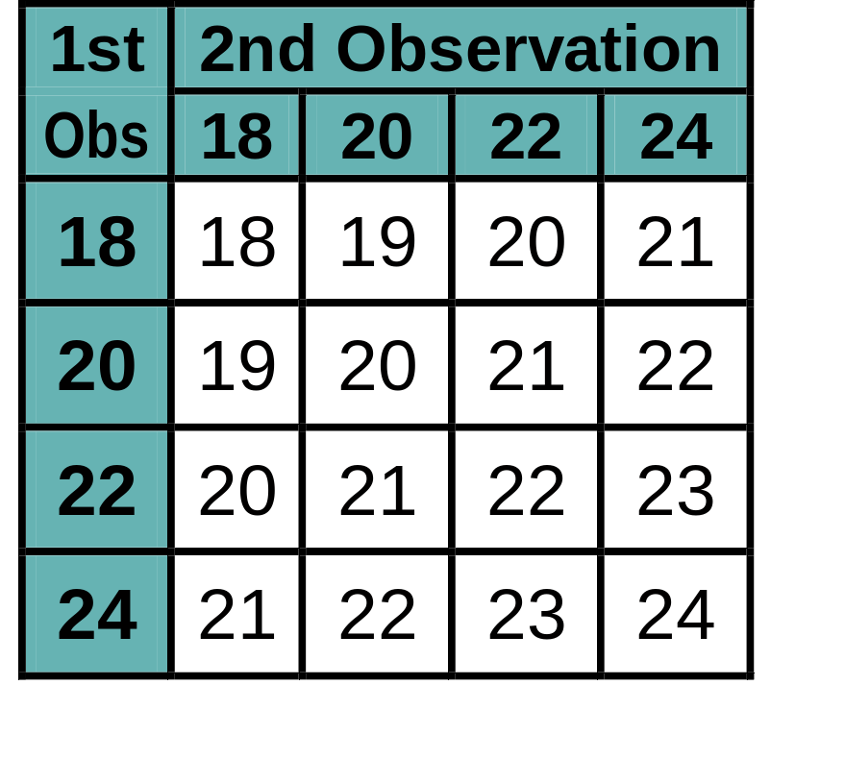
Now consider all possible samples of size n=2
Developing a
Sampling Distribution
(continued)
16 Sample Means
1st Obs | 2nd Observation
 | 18 | 20 | 22 | 24
18 | 18,18 | 18,20 | 18,22 | 18,24
20 | 20,18 | 20,20 | 20,22 | 20,24
22 | 22,18 | 22,20 | 22,22 | 22,24
24 | 24,18 | 24,20 | 24,22 | 24,24
16 possible samples (sampling with replacement)
Basic Business Statistics, 11e © 2009 Prentice-Hall, Inc..
Chap 7-<number>

Slide 22
Sampling Distribution of All Sample Means
Developing a
Sampling Distribution
(continued)
16 Sample Means
Sample Means Distribution
_
P(X)
.3
.2
.1
0
_
18 19 20 21 22 23 24
X
(no longer uniform)
Basic Business Statistics, 11e © 2009 Prentice-Hall, Inc..
Chap 7-<number>

Slide 23
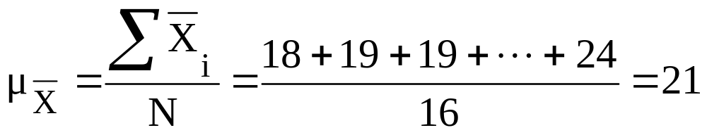
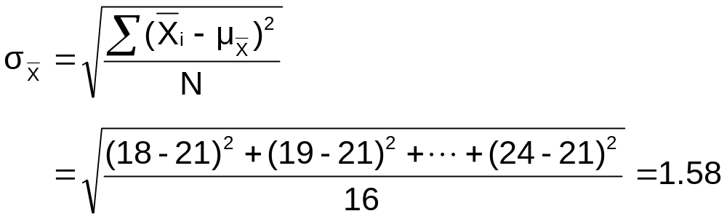
Summary Measures of this Sampling Distribution:
Developing a
Sampling Distribution
(continued)
Basic Business Statistics, 11e © 2009 Prentice-Hall, Inc..
Chap 7-<number>

Slide 24
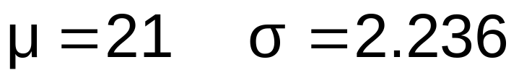
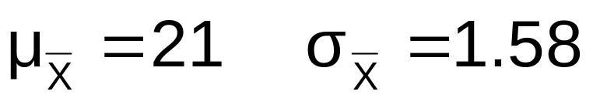
Comparing the Population Distribution to the Sample Means Distribution
Population
N = 4
Sample Means Distribution
n = 2
_
P(X)
P(X)
.3
.3
.2
.2
.1
.1
0
0
_
18 20 22 24
A B C D
X
18 19 20 21 22 23 24
X
Basic Business Statistics, 11e © 2009 Prentice-Hall, Inc..
Chap 7-<number>

Slide 25
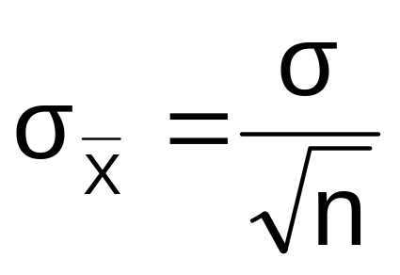
Sample Mean Sampling Distribution:
Standard Error of the Mean
Different samples of the same size from the same population will yield different sample means
A measure of the variability in the mean from sample to sample is given by the Standard Error of the Mean:
(This assumes that sampling is with replacement or
sampling is without replacement from an infinite population)
Note that the standard error of the mean decreases as the sample size increases
Basic Business Statistics, 11e © 2009 Prentice-Hall, Inc..
Chap 7-<number>

Slide 26

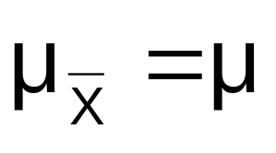
Sample Mean Sampling Distribution:
If the Population is Normal
If a population is normal with mean μ and standard deviation σ, the sampling distribution of is also normally distributed with
and
Basic Business Statistics, 11e © 2009 Prentice-Hall, Inc..
Chap 7-<number>

Slide 27

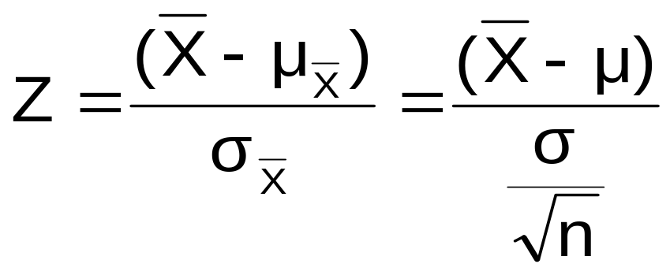



Z-value for Sampling Distribution of the Mean
Z-value for the sampling distribution of :
where: = sample mean
= population mean
= population standard deviation
n = sample size
Basic Business Statistics, 11e © 2009 Prentice-Hall, Inc..
Chap 7-<number>

Slide 28
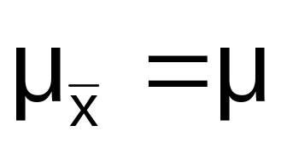




Sampling Distribution Properties
Normal Population Distribution
(i.e. is unbiased )
Normal Sampling Distribution
(has the same mean)
Basic Business Statistics, 11e © 2009 Prentice-Hall, Inc..
Chap 7-<number>

Slide 29


Sampling Distribution Properties
(continued)
  As n increases,
  decreases
Larger sample size
Smaller sample size
Basic Business Statistics, 11e © 2009 Prentice-Hall, Inc..
Chap 7-<number>

Slide 30
Determining An Interval Including A Fixed Proportion of the Sample Means
Find a symmetrically distributed interval around µ that will include 95% of the sample means when µ = 368, σ = 15, and n = 25.
  Since the interval contains 95% of the sample means 5% of the sample means will be outside the interval
  Since the interval is symmetric 2.5% will be above the upper limit and 2.5% will be below the lower limit.
  From the standardized normal table, the Z score with 2.5% (0.0250) below it is -1.96 and the Z score with 2.5% (0.0250) above it is 1.96.
Basic Business Statistics, 11e © 2009 Prentice-Hall, Inc..
Chap 7-<number>

Slide 31
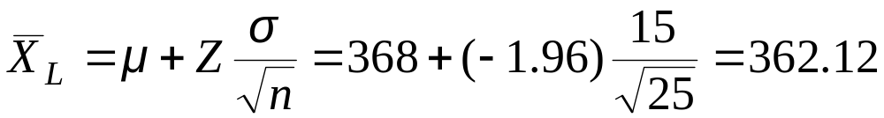
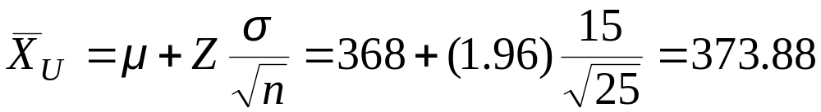
Determining An Interval Including A Fixed Proportion of the Sample Means
(continued)
Calculating the lower limit of the interval
Calculating the upper limit of the interval
95% of all sample means of sample size 25 are between 362.12 and 373.88
Basic Business Statistics, 11e © 2009 Prentice-Hall, Inc..
Chap 7-<number>

Slide 32
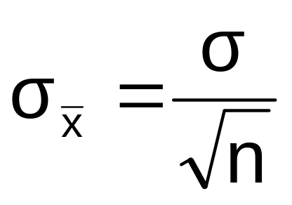
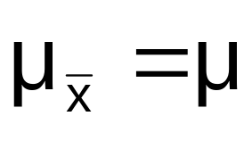
Sample Mean Sampling Distribution:
If the Population is not Normal
We can apply the Central Limit Theorem:
  Even if the population is not normal,
  …sample means from the population will be approximately normal as long as the sample size is large enough.
  Properties of the sampling distribution:
  and
Basic Business Statistics, 11e © 2009 Prentice-Hall, Inc..
Chap 7-<number>

Slide 33
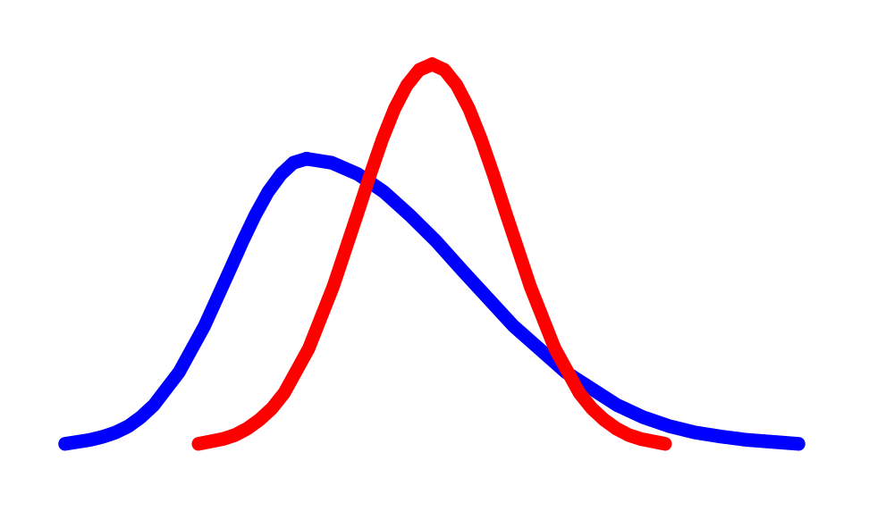
Central Limit Theorem
the sampling distribution becomes almost normal regardless of shape of population
As the sample size gets large enough…
n↑
Basic Business Statistics, 11e © 2009 Prentice-Hall, Inc..
Chap 7-<number>

Slide 34


Sample Mean Sampling Distribution:
If the Population is not Normal
(continued)
Population Distribution
Sampling distribution properties:
Central Tendency
Variation
Sampling Distribution
(becomes normal as n increases)
Larger sample size
Smaller sample size
Basic Business Statistics, 11e © 2009 Prentice-Hall, Inc..
Chap 7-<number>

Slide 35
How Large is Large Enough?
For most distributions, n > 30 will give a sampling distribution that is nearly normal
For fairly symmetric distributions, n > 15
For normal population distributions, the sampling distribution of the mean is always normally distributed
Basic Business Statistics, 11e © 2009 Prentice-Hall, Inc..
Chap 7-<number>

Slide 36
Example
Suppose a population has mean μ = 8 and standard deviation σ = 3. Suppose a random sample of size n = 36 is selected.
What is the probability that the sample mean is between 7.8 and 8.2?
Basic Business Statistics, 11e © 2009 Prentice-Hall, Inc..
Chap 7-<number>

Slide 37


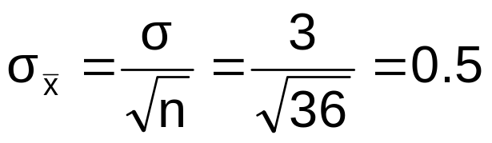
Example
(continued)
Solution:
Even if the population is not normally distributed, the central limit theorem can be used (n > 30)
… so the sampling distribution of is approximately normal
… with mean = 8
…and standard deviation
Basic Business Statistics, 11e © 2009 Prentice-Hall, Inc..
Chap 7-<number>

Slide 38
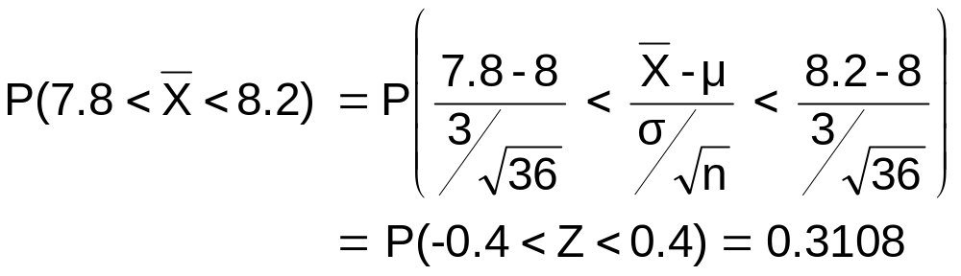




Example
(continued)
Solution (continued):
Population Distribution
Sampling Distribution
Standard Normal Distribution
.1554 +.1554
?
?
?
?
?
?
?
?
?
?
Sample
Standardize
?
?
7.8 8.2
-0.4 0.4
Z
X
Basic Business Statistics, 11e © 2009 Prentice-Hall, Inc..
Chap 7-<number>

Slide 39
Chapter Summary
Discussed probability and nonprobability samples
Described four common probability samples
Examined survey worthiness and types of survey errors
Introduced sampling distributions
Described the sampling distribution of the mean
  For normal populations
  Using the Central Limit Theorem
Calculated probabilities using sampling distributions
Basic Business Statistics, 11e © 2009 Prentice-Hall, Inc..
Chap 7-<number>

